Slide 1

FAKE MEDICINE DETECTION SYSTEM
American International University-Bangladesh Software Engineering[K]
Group - 10

Slide 2
Submitted To :
DR. RAZIB HAYAT KHAN
Assistant Professor
Department of Computer Science
American International University-Bangladesh
Group Members:
1.JOY MATUBBER (20-41959-1)
2.MARUF SHAHRIAR (20-42016-1)
3.NAFINUR LEO (20-42195-1)

Slide 3
Introduction
This project is made to detect if a medicine is fake or not. This helps people to figure out the authenticity of medicine through some simple process.
Demand for this project
As the global pandemic is taking a turn for the worse, the rise of fake or Suspicious drugs” are on an all time high.
Functionality of this project
The project is developed for mobile devices and it’s easy to use interface is simple to use and interact.

Slide 4
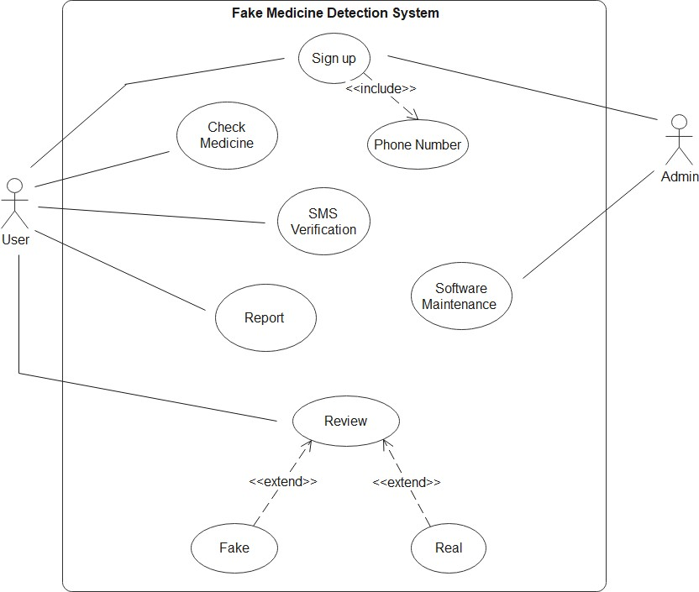
Use Case :

Slide 5
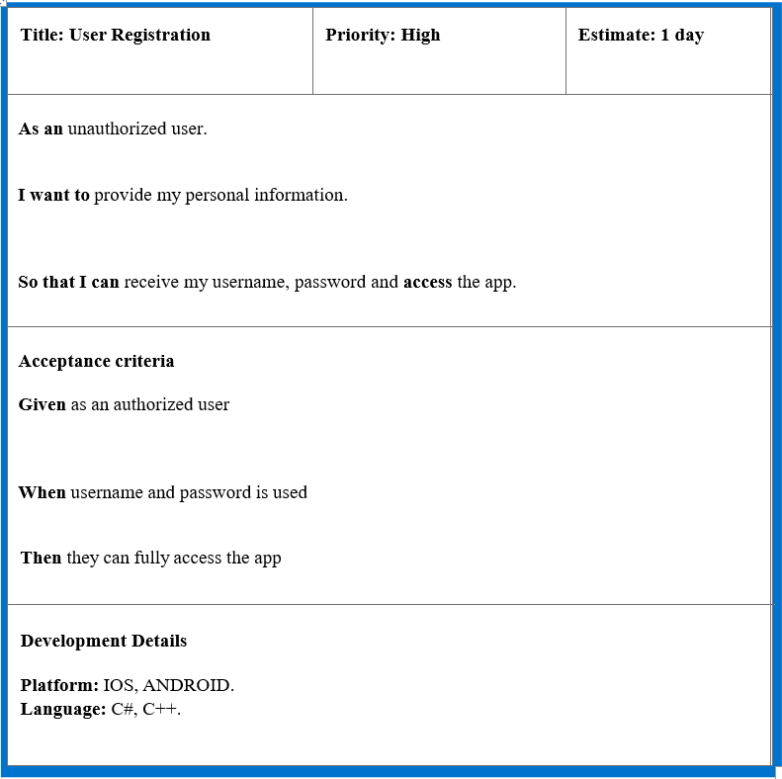
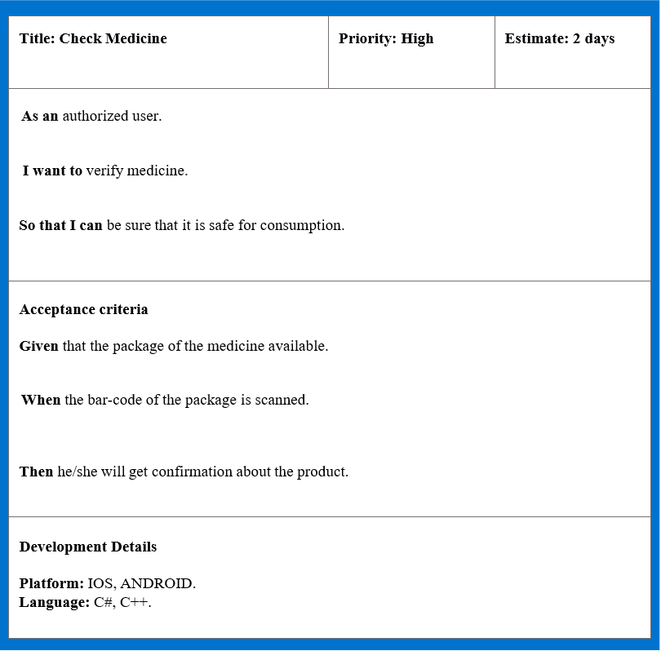
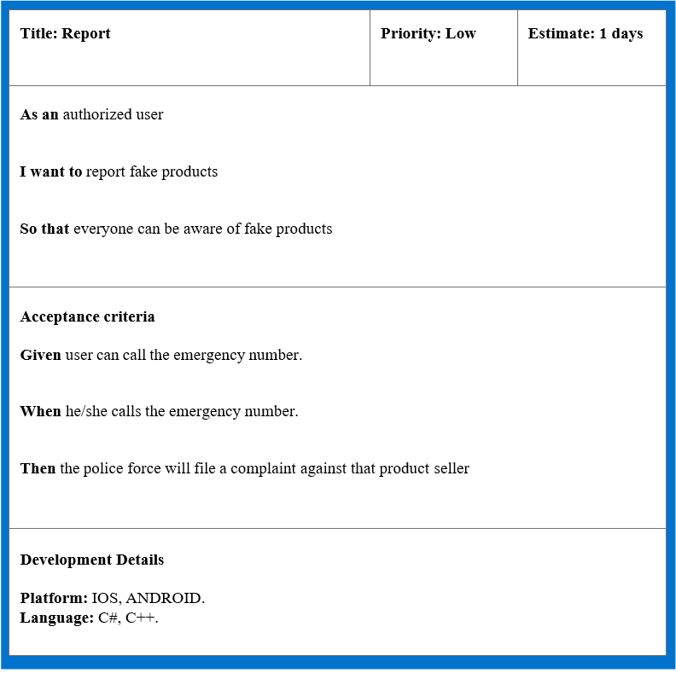
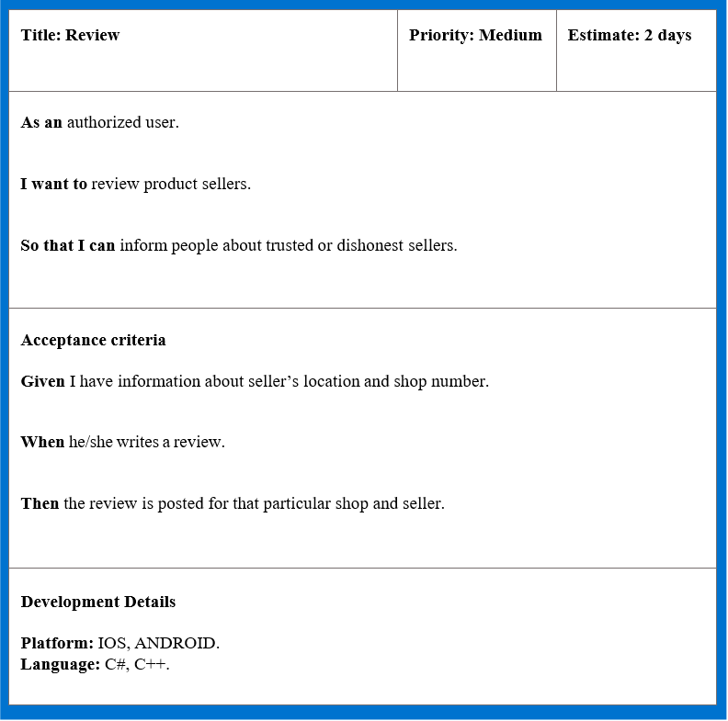
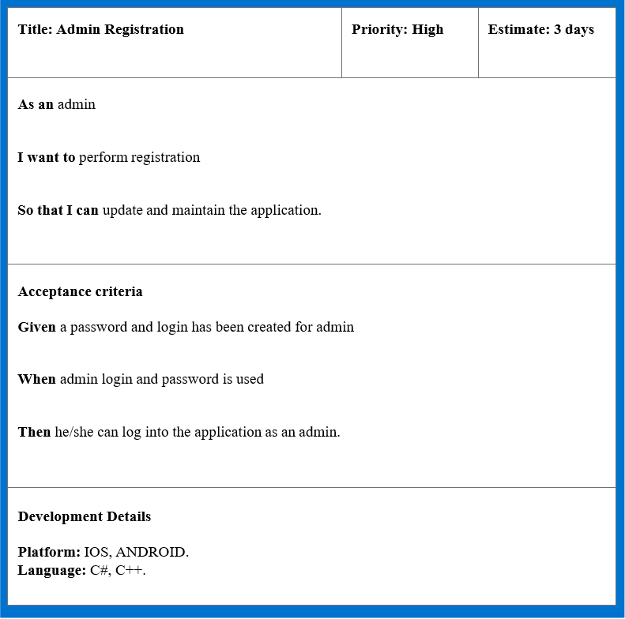
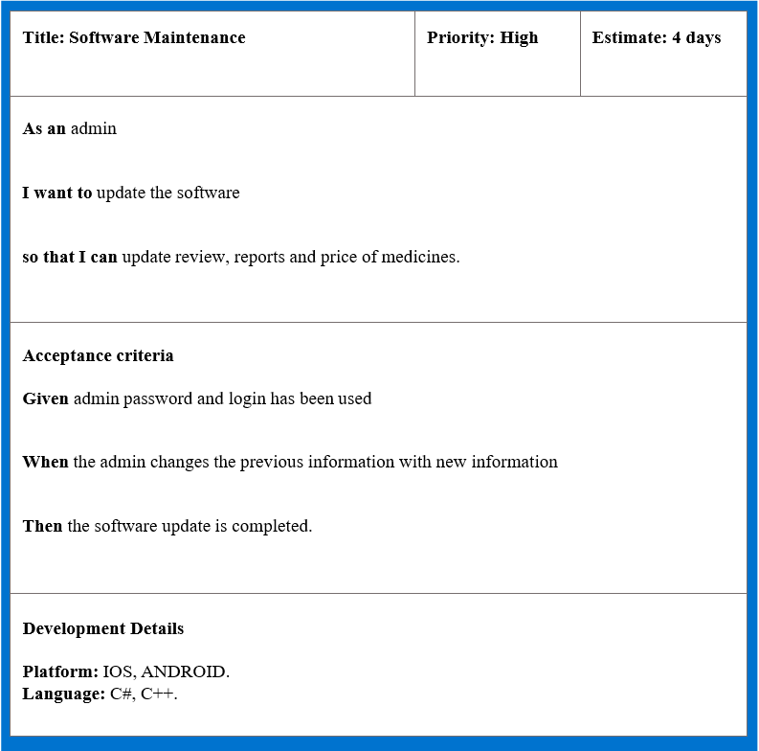
User
Story
Card

Slide 6
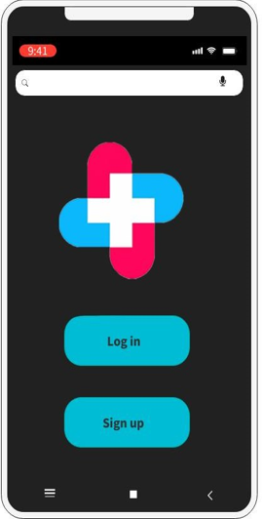
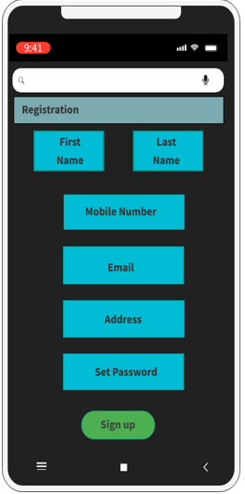
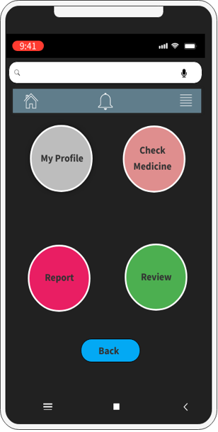
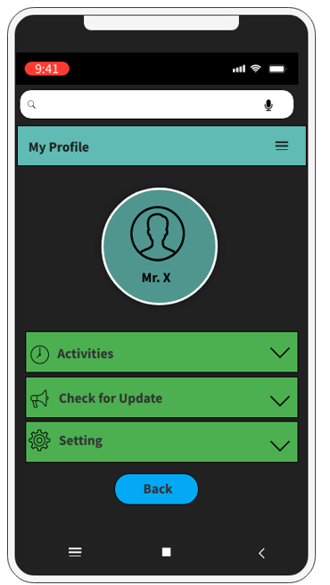
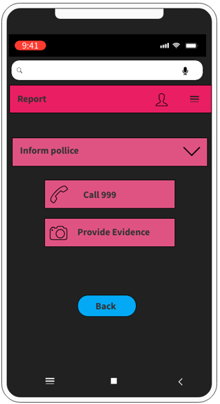
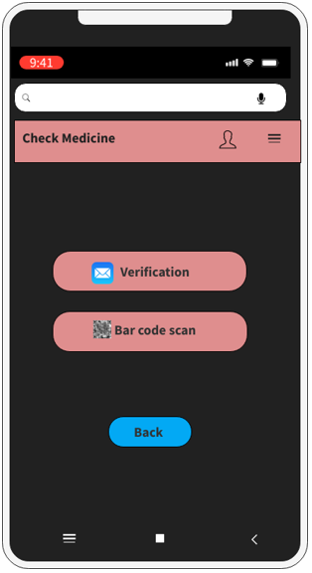
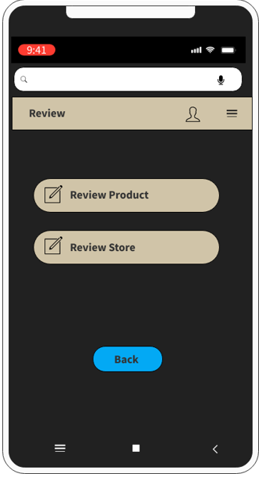
UI Design

Slide 7
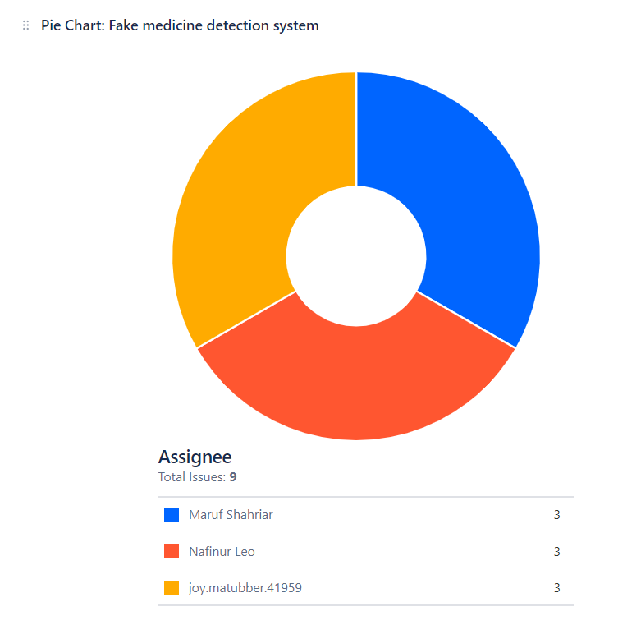
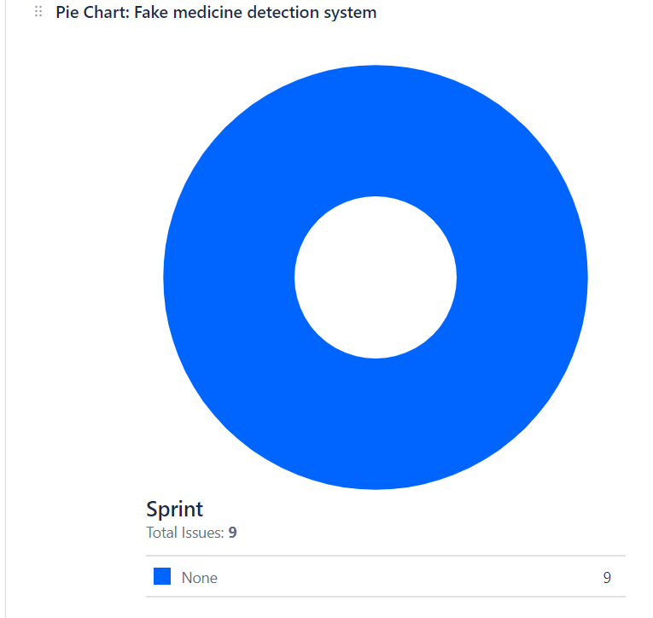
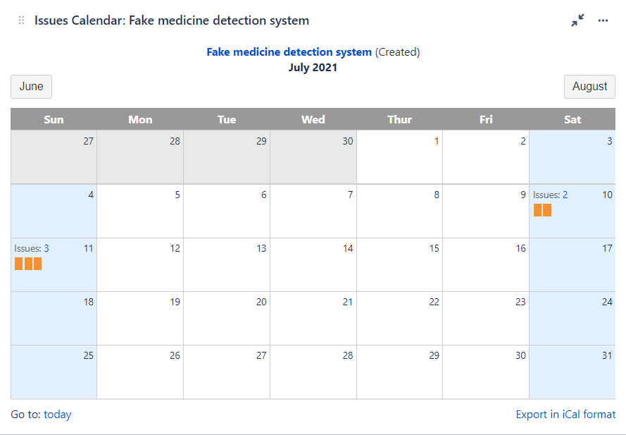
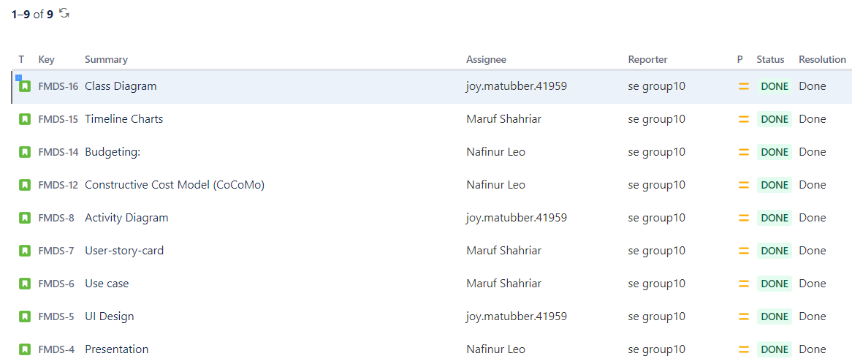
jira

Slide 8
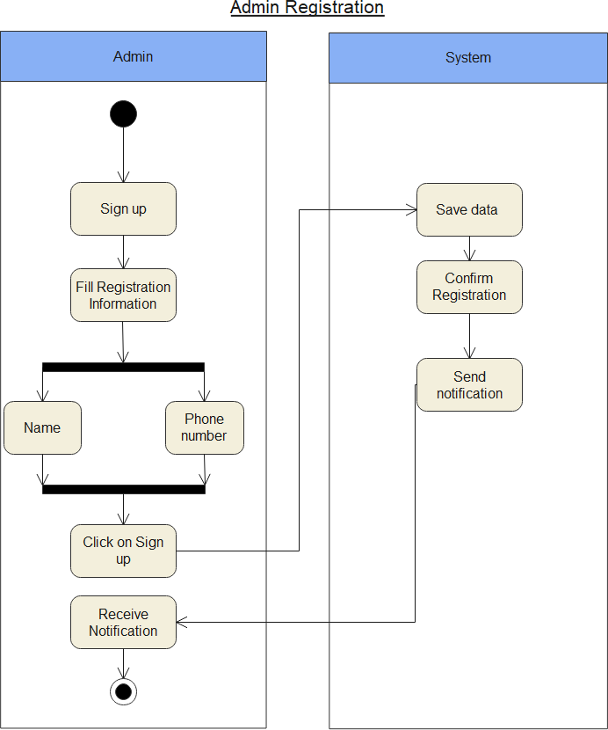
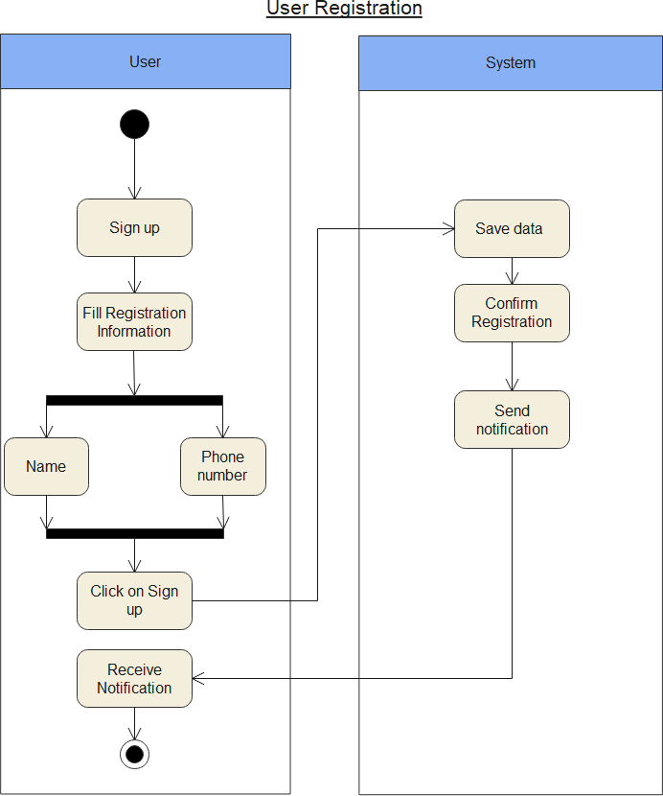
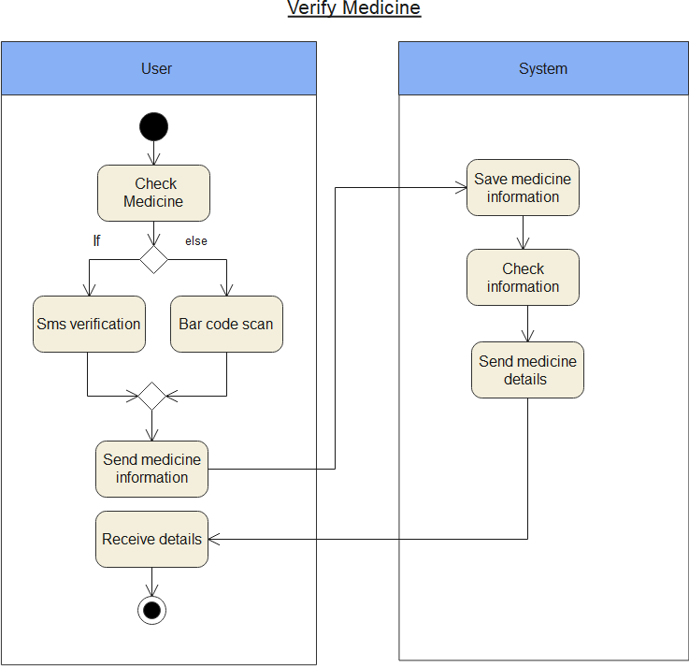
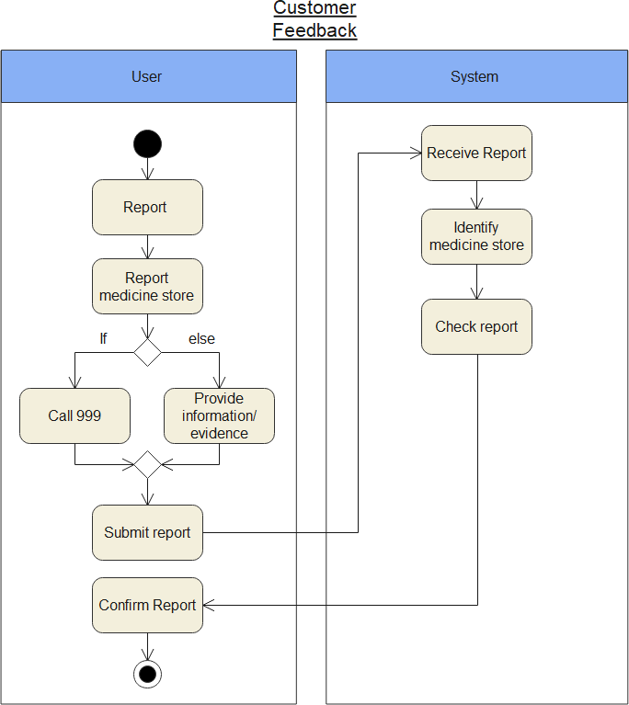
Activity Diagram

Slide 9
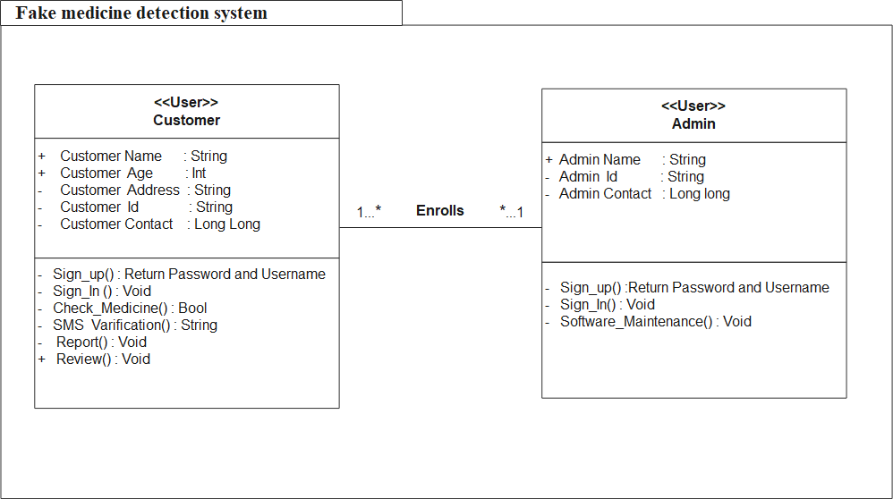
Class Diagram

Slide 10
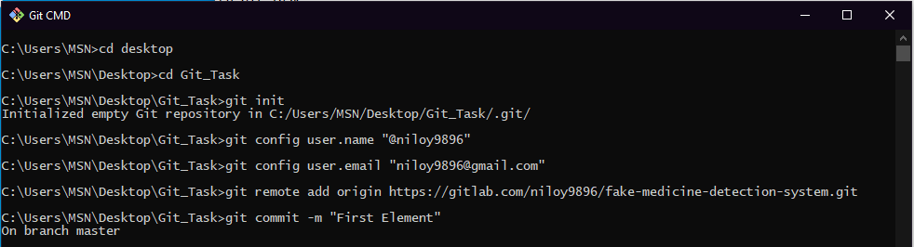
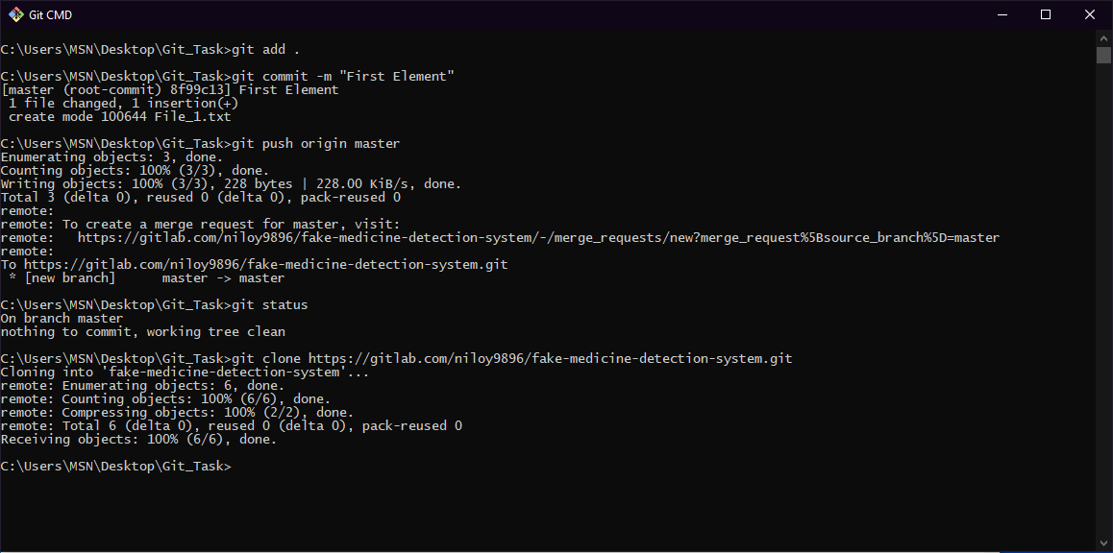
Git

Slide 11
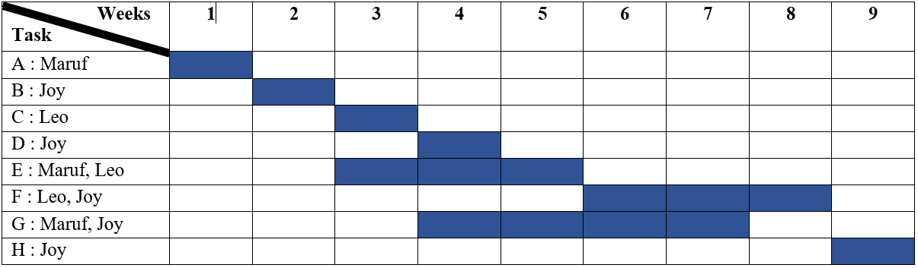
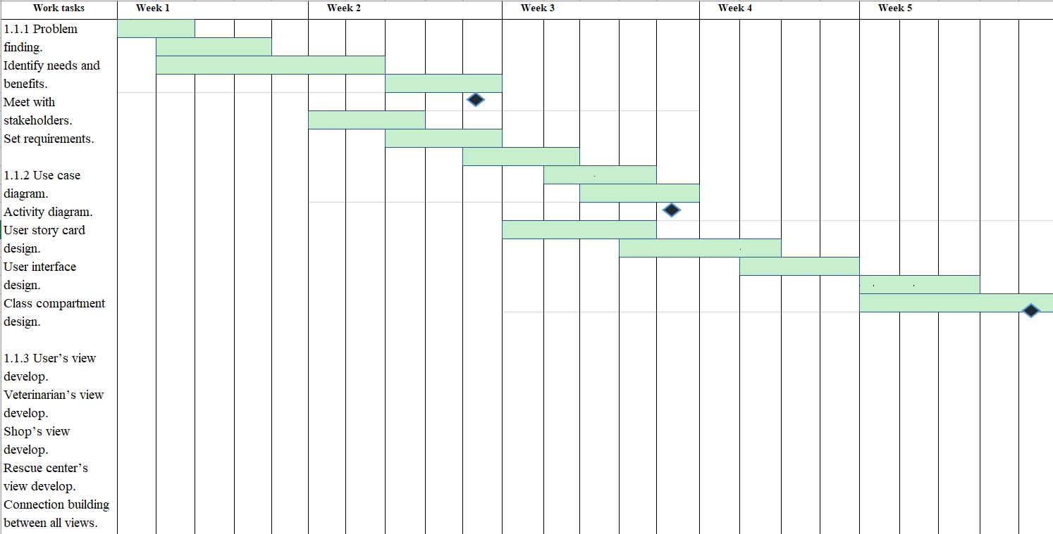
Timeline Chart
Activity key:
A: Requirement analysis E: Testing
B: Designing/Modeling F:Implementation/Integration
C: Coding/Development G: Operation/Maintenance
D: Research H: Documentation

Slide 12
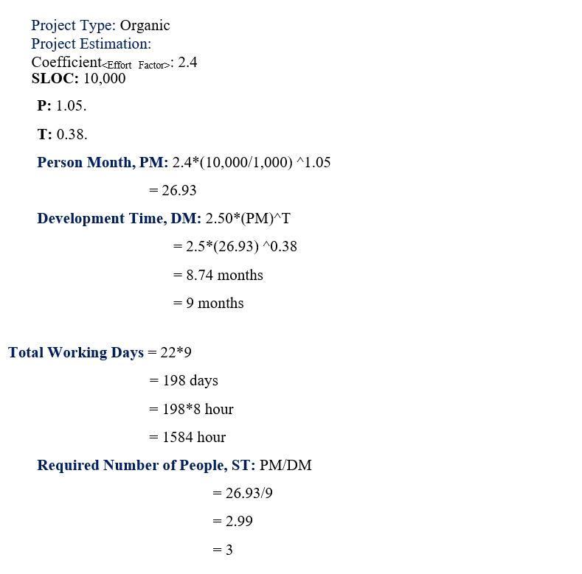
Constructive Cost Model
(CoCoMo)

Slide 13
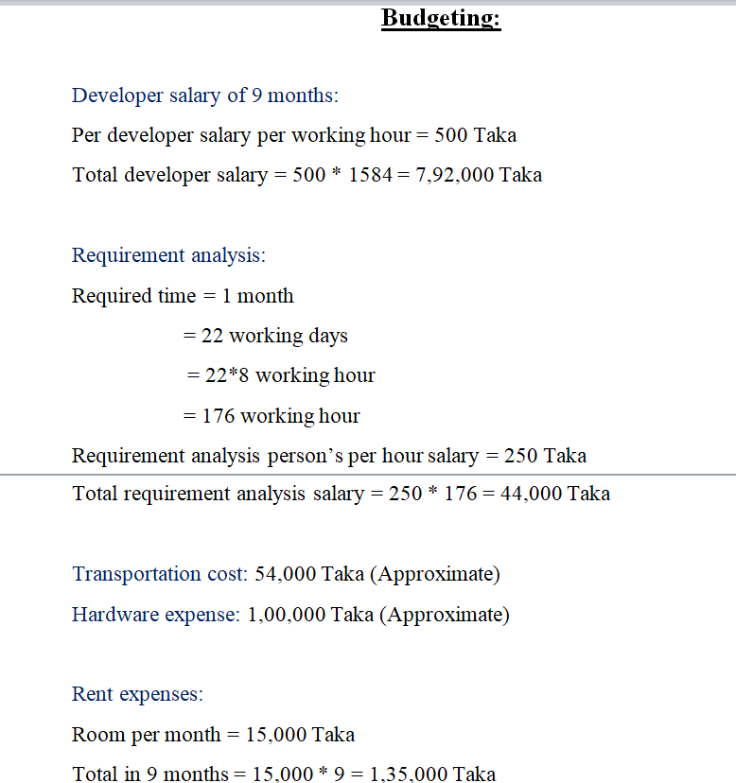
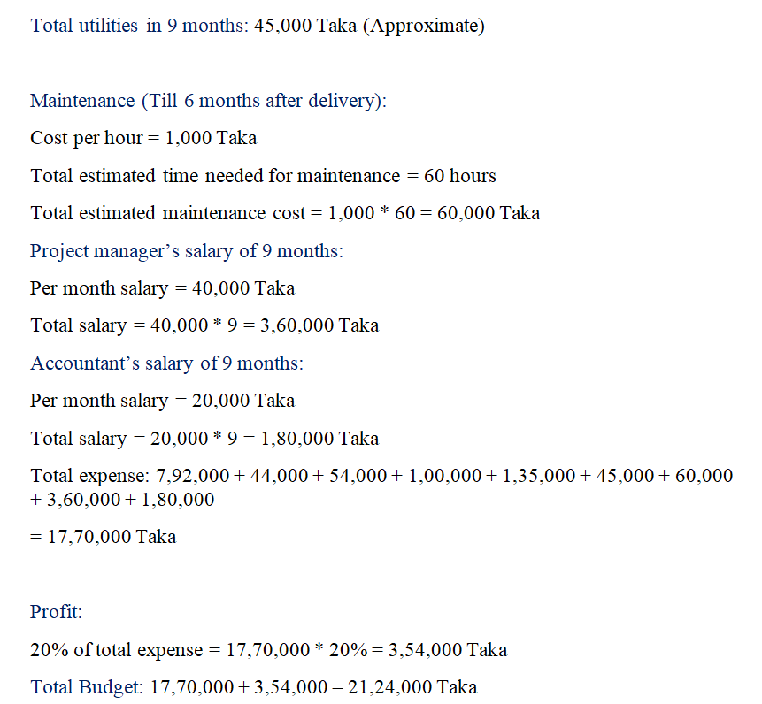
Budget
Management

Slide 14
Thank You

